Slide 1
Steel Defects Classification and Segmentation
By
Faizanuddin Siddique

Slide 2
AIM
Detect Whether the image has a defect or not.
Classifying types of defects and localizing them with the help of a mask.
Notes:
Deep learning has been proven to be superior in detecting and localizing defects using imagery data which could significantly improve the production efficiency in the manufacturing industry
Detecting defects would help in improving the quality of manufacturing as well as in reducing the waste due to production defects.

Slide 3
The Solution
Our model correctly identifies defective and non-defective images with 88% accuracy.
Model also classifies types of defects for defective images.
Notes:
Model classifies between defective and non defective images also model segments the defects and classifies types of defects

Slide 4
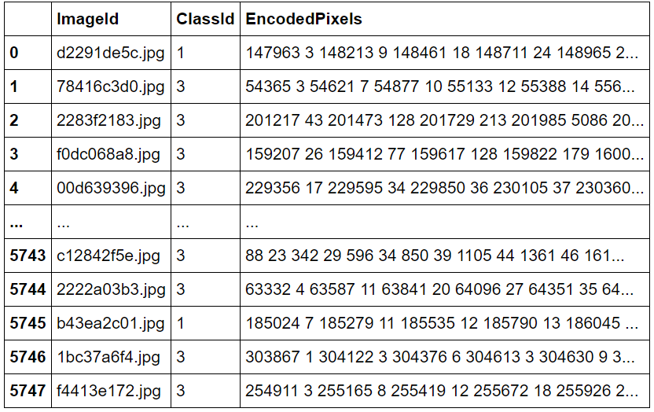
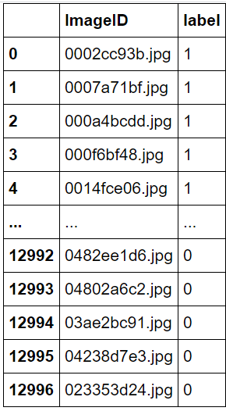
The Data
Defective images
All images dataset
Data Source: https://www.kaggle.com/c/severstal-steel-defect-detection/data
Notes:
Data contains around 12600 images with 4 classes of defects, we aim to detect:
Detect Whether the image has a defect or not.
Classifying types of defects and localizing them with the help of a mask.

Slide 5
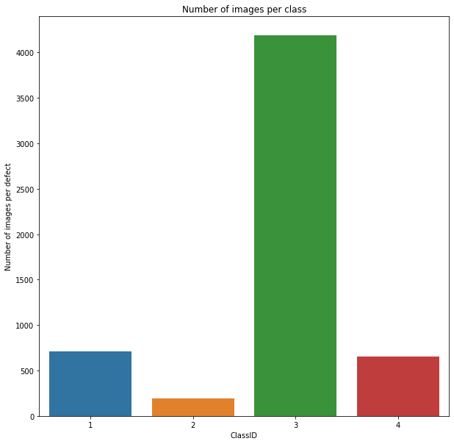
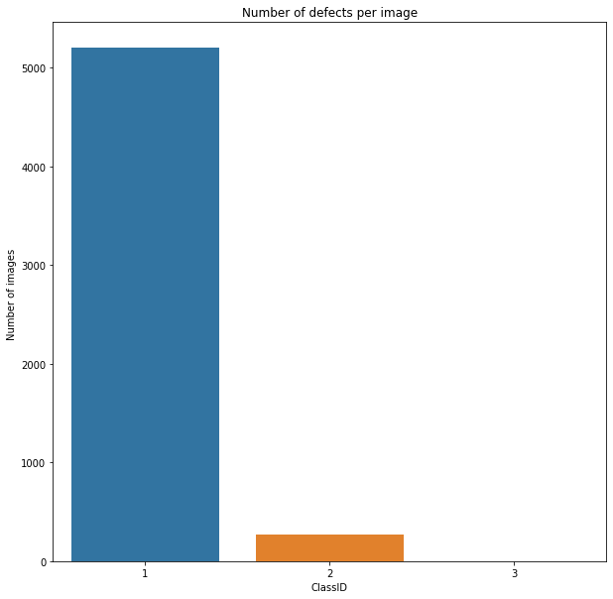
Eda and Data visualization
Notes:
Visualizing the Defective images dataset, we find out there is a class imbalance in the dataset with a prominent class being as a defect with class 3.
5201 images having only 1 defect
272 images having 2 defects
1 image having all the defects.

Slide 6
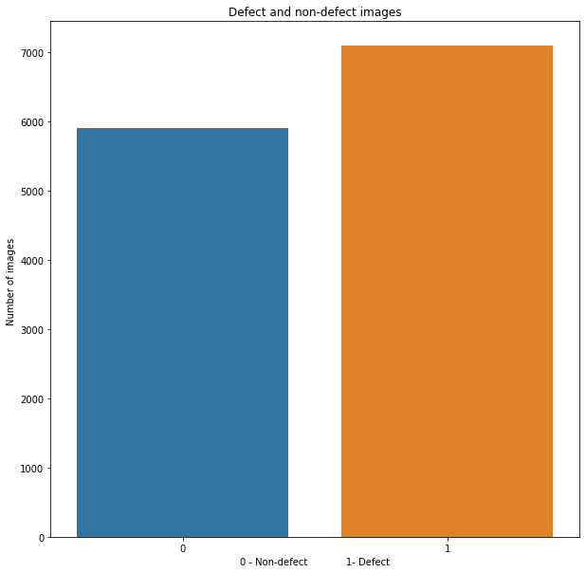


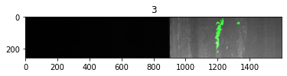
Eda and Data visualization
Notes:
There are around 7000 images with defects and nearly 5400 with no defects
Sometimes it is hard to represent a mask using an index as it would make the length of the mask equal to the product of height and width of the image
To overcome this, we use a lossless data compression technique called Run-length encoding (RLE), which stores sequences that contain many consecutive data elements as a single data value followed by the count.
For example, assume we have an image (single row) containing plain black text on a solid white background. B represents a black pixel and W represents white:
Its run length encoding is 12W1B12W3B24W1B14W
This can be interpreted as a sequence of twelve Ws, one B, twelve Ws, three Bs, etc.

Slide 7
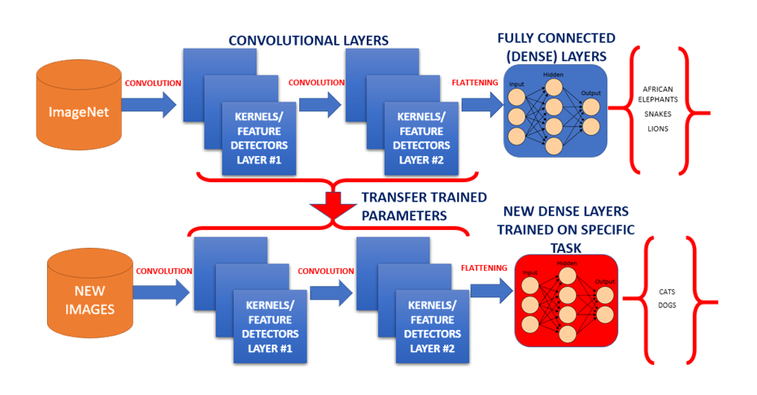
Model Preparation and Comparison
.
Notes:
In the first step, we need to classify images into whether it's defective or not for this we have split the data into test and train with a ratio as 0.15 to 0.85.
Also, we have used image augmentation by using an image data generator further splitting the data into training and validation datasets.
Image augmentation was also performed for the test dataset.
We have used base model as ResNet and have used the concept of transfer learning by using the pre calculated weights for Resnet model

Slide 8
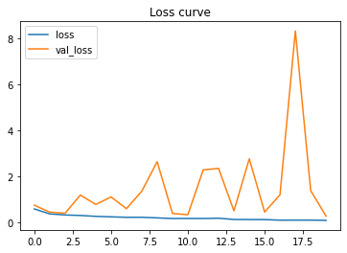
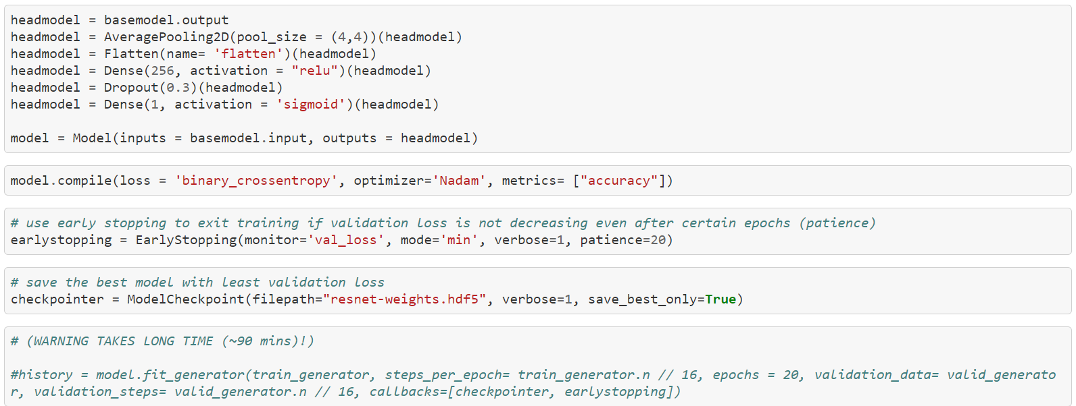
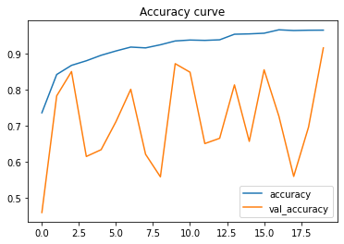
Model Summary and Results
.
After compiling and fitting the model an accuracy of 96.48% on train dataset and a validation accuracy of 91.57% was observed.
For the test data model, accuracy came out to be 88.42%.

Slide 9
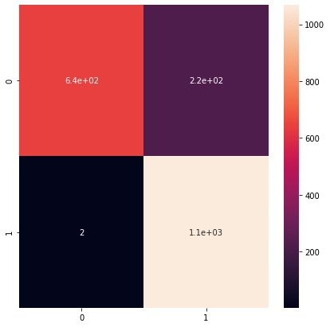
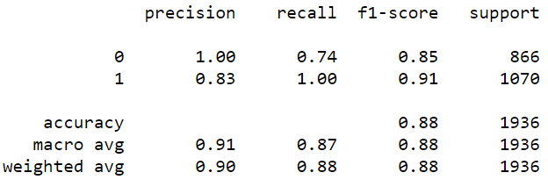
Model Summary and Results
.
Confusion Matrix
Classification Report

Slide 10
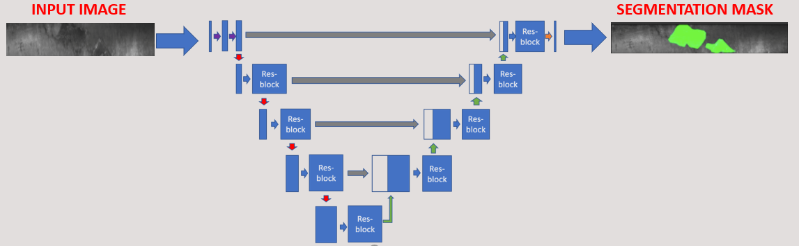
Image segmentation
.
The goal of image segmentation is to understand and extract information from images at the pixel level.
Image Segmentation can be used for object recognition and localization which offers tremendous value in many applications such as medical imaging and self-driving cars etc.
The goal of image segmentation is to train a neural network to produce a pixel-wise mask of the image.
Res Unet Segmentation

Slide 11
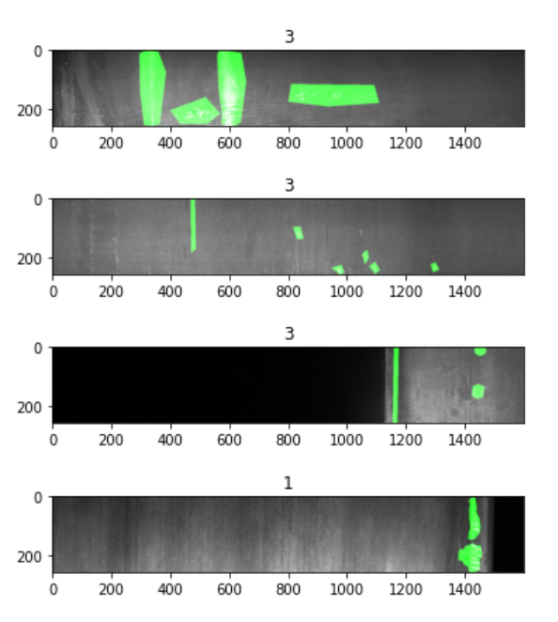
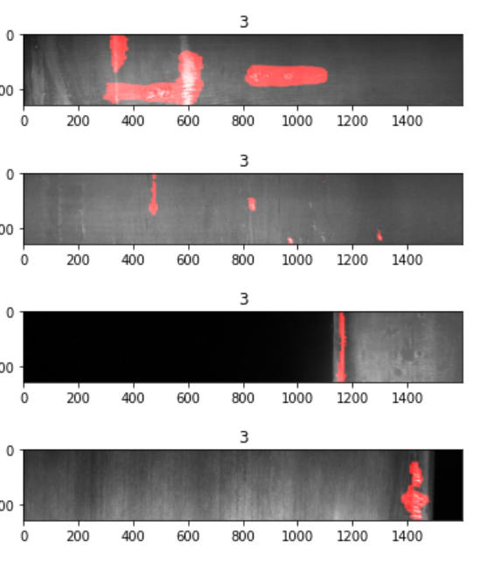
Image segmentation Result
.
Train set Test Set

Slide 12
Takeaways
After compiling and fitting the model an accuracy of 96.48% on train dataset and a validation accuracy of 91.57% was observed.
For the test data model, accuracy came out to be 88.42%.
Image segmentation model is working fine however we need to some metric to compare our test and training results both segmentation and class predictions.

Slide 13
Future Research
For the segmentation model we need to come up with some metric to compare our test and training results both segmentation and class predictions.
Furthermore, work needs to be done how can we put the model inro production for real time testing.
Model Retraining approach can be applied for training the model for new images or new defects.

Slide 14
Thank You!
Springboard Team for guidance throught
Devesh Raj for guidance during project
Lavanya Tekumala for pointing out the improvements that can be done in the model.

Slide 15
Questions?

